Slide 1
Automatic Alternative Image Recognition to Voice

Slide 2
Phan Trung Thành (Leader)
Nguyễn Vũ Hoàng Sơn
Võ Hà Quân
Nguyễn Cao Duy (Dropped Out)
Supervisor
Kiều Trọng Khánh

Slide 3
Outline
01
01
Problem
02
Our Solution
03
Main features
04
Future plan
05
Technologies - Devlopment Environment

Slide 4
Introduction
Introduction

Slide 5
Automatic Alternative Image Recognition to Voice
What problems that blind People face in life ?
Notes:
Objects obstacles.
Traveling
Walking on street

Slide 6
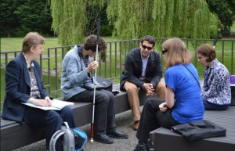
Automatic Alternative Image Recognition to Voice
What problems that blind People face in life ?
Social challenges.
Notes:
Meeting people
Participate in activities
=> Low self esteem

Slide 7
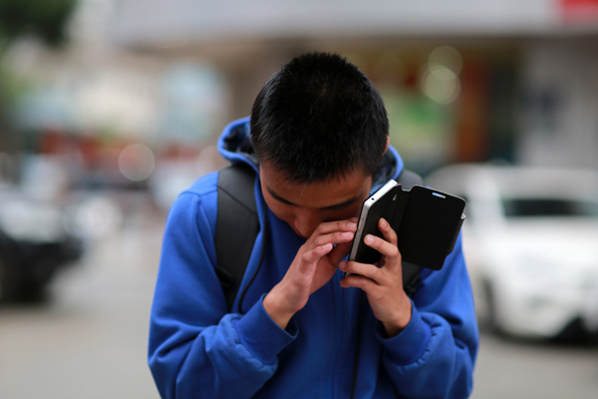
Automatic Alternative Image Recognition to Voice
What problems that blind People face in life ?
Social challenges.
Technologies using difficulty

Slide 8
Common Solutions

Slide 9
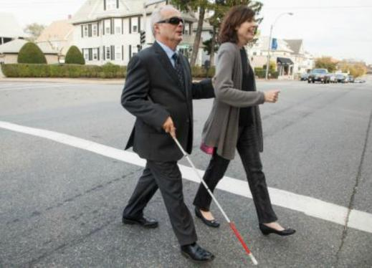
Common Solutions
Helpers

Slide 10
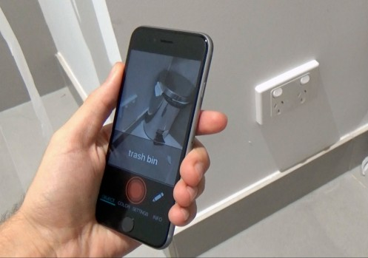
Common Solutions
Helpers

Slide 11
Introduction
Our Solution

Slide 12
Our Solution
See4U – A Portable Assistance for Blind Person
Notes:
#chua noi den voice regconition

Slide 13
Our Solution
See4U – A Portable Assistance for Blind Person
A system that can support blind person to identify People and Objects around them.

Slide 14
Our Solution
See4U – A Portable Assistance for Blind Person
A system that can support blind person to identify People and Objects around them.
Support blind person to communicate with the application by their own voice.

Slide 15


Main Features
See4U helps blind person to recognize People and Objects around them
Identify Person
Identify Objects
Notes:
#chua noi den voice regconition

Slide 16

Main Features
See4U can upgrades its performance with the help of its Users, Manually or through Voice commands
Identify Person
Identify Objects
Training
Voice Control
Notes:
#chua noi den voice regconition

Slide 17


Automatic Alternative Image Recognition to Voice
Roles
Member
Admin

Slide 18



Automatic Alternative Image Recognition to Voice
Roles
Detect Person
Detect Object
Train Person
Member
Control by Voice

Slide 19


Automatic Alternative Image Recognition to Voice
Roles
Account Management
Train Object
Manage Objects
Admin

Slide 20
Person
Identification
Introduction

Slide 21
Person Identification
Scenario

Slide 22

Person Identification
Scenario
Mr. Son is a blind person. He is walking on the street when suddenly run into his friend, Mr. Thanh.
Mr. Son

Slide 23

Person Identification
Scenario
Mr. Thanh says “Hello” to Mr. Son
Mr. Son
Mr. Thanh

Slide 24
Person Identification
Scenario
Mr. Thanh says “Hello” to Mr. Son
Hello !
Mr. Son
Mr. Thanh

Slide 25
Person Identification
Traditional Approach
Whose voice is that ?
It is common sense that Mr. Son will wonder: “Whose voice is that ?”
Mr. Son

Slide 26

Person Identification
Traditional Approach
It might take some times for Mr. Son to recognizer who is calling him.
Mr. Son

Slide 27
Person Identification
Traditional Approach
Oh, It might be Thanh…
Mr. Son

Slide 28
Person Identification
Traditional Approach
Oh, It might be Thanh…
… I think so.
But still, he is not so sure.
Mr. Son

Slide 29
Person Identification
Our Approach

Slide 30

Person Identification
Our Approach
Recognize automatically
Mr. Son
Mr. Thanh

Slide 31
Person Identification
Our Approach
He’s Thanh
Thanh
And describe back to the blind
Mr. Son

Slide 32
Person Identification
Our Approach
Oh, it’s Thanh !
But still, he is not so sure.
Mr. Son

Slide 33
Person Identification
Our Proposal

Slide 34

Person Identification
Our Proposal
System

Slide 35
Person Identification
Our Proposal
Detect Person
System

Slide 36
Person Identification
Our Proposal
Describe the Person back to the blind
Detect Person
System

Slide 37
Person Identification
Our Proposal
Describe the Person back to the blind
Detect Person
System
The blind know who is the Person calling them

Slide 38
Person Identification
Our Proposal
Describe the Person back to the blind
Detect Person
System
User can now greeting the person properly
The blind know who is the Person calling them

Slide 39
Person Identification
How can we do that ?

Slide 40

Person Identification
How can we do that ?
Device Camera

Slide 41
Person Identification
How can we do that ?
Device Camera
Capture picture of the Person

Slide 42

Person Identification
How can we do that ?
Device Camera
System
Capture picture of the Person

Slide 43
Person Identification
How can we do that ?
Device Camera
System
Capture picture of the Person
Process

Slide 44

Person Identification
How can we do that ?
Device Camera
System
Image Recognizer
Capture picture of the Person
Process

Slide 45
Person Identification
How can we do that ?
Device Camera
System
Image Recognizer
Capture picture of the Person
Process
Facial Identification

Slide 46

Person Identification
How can we do that ?
1. Capture Picture
Device Camera
Notes:
Qui trình như sau

Slide 47
Person Identification
How can we do that ?
1. Capture Picture
Device Camera
System

Slide 48
Person Identification
How can we do that ?
2. Send Image
1. Capture Picture
Device Camera
System
Image Recognizer

Slide 49
Person Identification
How can we do that ?
2. Send Image
1. Capture Picture
Device Camera
System
3. Response Result
Image Recognizer

Slide 50
Person Identification
How can we do that ?
2. Send Image
1. Capture Picture
Device Camera
System
3. Response Result
Image Recognizer
4. Process

Slide 51

Person Identification
How can we do that ?
2. Send Image
1. Capture Picture
Device Camera
System
3. Response Result
Image Recognizer
4. Process
5. Describe
Blind user

Slide 52

Person Identification
How can we do that ?
2. Send Image
1. Capture Picture
Device Camera
System
3. Response Result
Image Recognizer
4. Process
5. Describe
Blind user

Slide 53
Person Identification
Technology
After spent times studying, we decided to use Microsoft Cognitive Service to be our Image Recognizer because its features is suitable for our approach.

Slide 54

Person Identification
Technology
Why do we choose Microsoft Cognitive Service ?

Slide 55
Person Identification
Technology
Why do we choose Microsoft Cognitive Service ?
Detect Human Faces, Gender, Age

Slide 56
Person Identification
Technology
Why do we choose Microsoft Cognitive Service ?
Detect Human Faces, Gender, Age
Train system to identify a Person

Slide 57
Person Identification
Technology
Why do we choose Microsoft Cognitive Service ?
Detect Human Faces, Gender, Age
Train system to identify a Person
Identify Person Face

Slide 58
How can we do that ?
Recognition Process contains 2 main steps:

Slide 59
How can we do that ?
Recognition Process contains 2 main steps:
Detect Human Face

Slide 60
How can we do that ?
Recognition Process contains 2 main steps:
Detect Human Face
Identify Person

Slide 61
Person Identification
Detect Human Face
How can a machine detect a Human Face ?

Slide 62
Person Identification
Detect Human Face
Understand a Human Face

Slide 63

Person Identification
Detect Human Face
Understand Human Face
This is how we see a Human Face

Slide 64
Person Identification
Detect Human Face
Understand Human Face
This is how we see a Human Face
Eyes

Slide 65
Person Identification
Detect Human Face
Understand Human Face
This is how we see a Human Face
Eyes
Nose

Slide 66
Person Identification
Detect Human Face
Understand Human Face
This is how we see a Human Face
Eyes
Nose
Mouth

Slide 67
Person Identification
Detect Human Face
Understand Human Face
We do this automatically
and instantly !

Slide 68
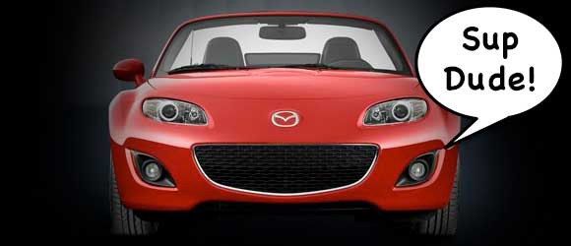
Person Identification
Detect Human Face
Understand Human Face
In fact, we are too good at it that we end up seeing faces in everyday objects.

Slide 69
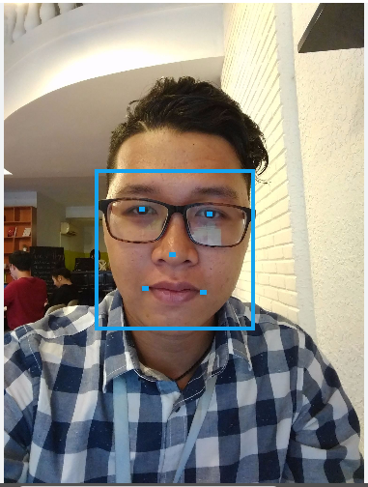
Person Identification
Detect Human Face
Understand Human Face
And this is how a Computer will see our Human Face.

Slide 70
Person Identification
Detect Human Face
Understand Human Face
And this is how a Computer will see our Human Face.
“Face Landmarks”

Slide 71
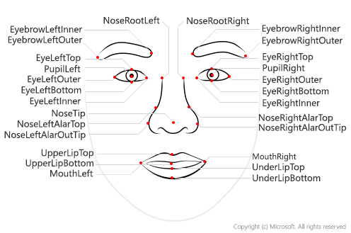
Person Identification
Detect Human Face
Understand Human Face

Slide 72
Person Identification
Detect Human Face
Facial Detection - How it works

Slide 73
Person Identification
Detect Human Face
To detect a Human Face, we use the method called “Histogram of Oriented Gradients”.

Slide 74

Person Identification
Detect Human Face
Facial Detection - How it works
Input

Slide 75
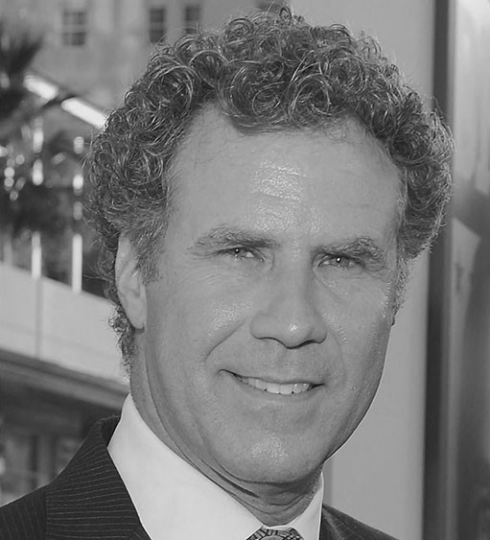
Person Identification
Detect Human Face
Facial Detection - How it works
Input
Convert to black and white

Slide 76
Person Identification
Detect Human Face
Facial Detection - How it works
Computers do not need color data to detect faces
Input
Convert to black and white

Slide 77
Person Identification
Detect Human Face
Facial Detection - How it works
Then we look at every single pixel of the image.
For each of the pixel, we want to look at the pixels directly surrounding it.

Slide 78
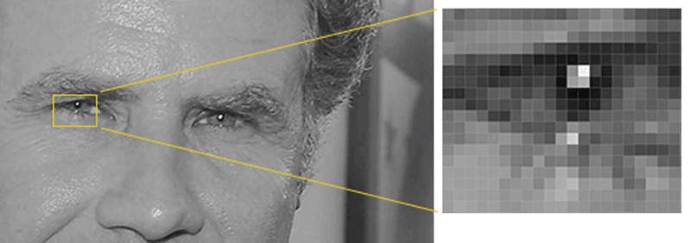
Person Identification
Detect Human Face
Facial Detection - How it works
Then we look at every single pixel of the image.
For each of the pixel, we want to look at the pixels directly surrounding it.

Slide 79
Person Identification
Detect Human Face
Facial Detection - How it works
Then we want to draw an arrow showing in which direction the image is getting darker.

Slide 80

Person Identification
Detect Human Face
Facial Detection - How it works
Then we want to draw an arrow showing in which direction the image is getting darker.

Slide 81
Person Identification
Detect Human Face
Facial Detection - How it works
Repeat that process for every single pixel in the image, you end up with every pixel being replaced by an arrow.

Slide 82

Person Identification
Detect Human Face
Facial Detection - How it works
Repeat that process for every single pixel in the image, you end up with every pixel being replaced by an arrow.
Notes:
If we analyze pixels directly, really dark images and really light images of the same person will have totally different pixel values. But by only considering the direction that brightness changes, both really dark images and really bright images will end up with the same exact representation. That makes the problem a lot easier to solve!

Slide 83
Person Identification
Detect Human Face
Facial Detection - How it works
Break up the image into small squares of 16x16 pixels each. In each square, we’ll count up how many gradients point in each major direction.

Slide 84
Person Identification
Detect Human Face
Facial Detection - How it works
Break up the image into small squares of 16x16 pixels each. In each square, we’ll count up how many gradients point in each major direction.
Then replace that square in the image with the arrow directions that were the strongest.

Slide 85

Person Identification
Detect Human Face
Facial Detection - How it works
This is how it looks like:

Slide 86
Person Identification
Detect Human Face
Facial Detection - How it works
Then to find out the Human Face, we have to find the part of our image that looks the most similar to a known HOG pattern that was extracted from a bunch of other training faces.

Slide 87
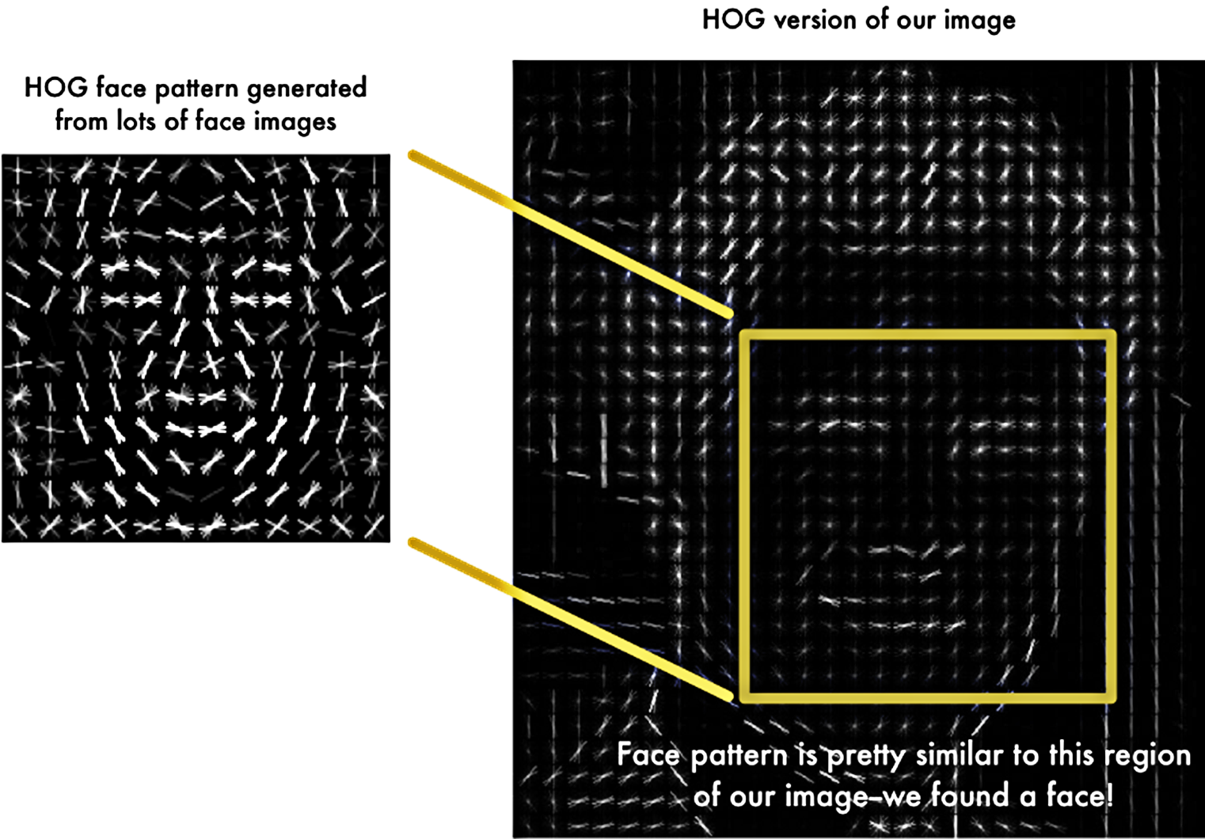
Person Identification
Detect Human Face
Facial Detection - How it works

Slide 88
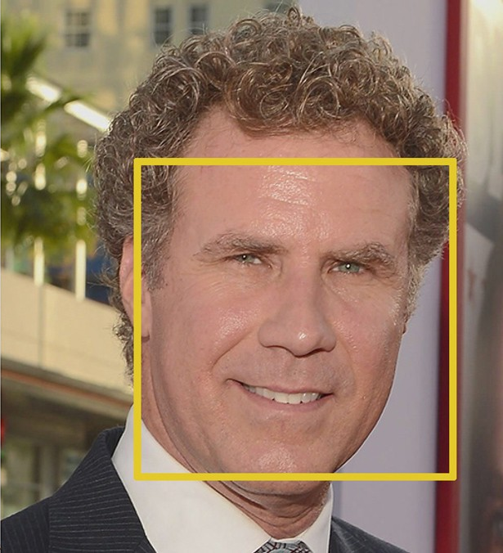
Person Identification
Detect Human Face
Facial Detection - How it works
Voila, a Face is found !

Slide 89
Person Identification
Identify a Person
The Identifying Process

Slide 90
Person Identification
Identify a Person
Identifying Process
Detect Human Face

Slide 91
Person Identification
Identify a Person
Identifying Process
Detect Human Face
Identify Face and get Candidates

Slide 92
Person Identification
Identify a Person
Identifying Process
Detect Human Face
Identify Face and get Candidates
Get Person Information

Slide 93
Person Identification
Identify a Person
Identifying Process
Detect Human Face
Identify Face and get Candidates
Get Person Information

Slide 94
Person Identification
Detect Human Face
Microsoft Cognitive Service
System
User

Slide 95

Person Identification
Detect Human Face
Microsoft Cognitive Service
System
1. Capture
User

Slide 96

Person Identification
Detect Human Face
Microsoft Cognitive Service
System
1. Capture
2. Detect API
User

Slide 97
Person Identification
Detect Human Face
Microsoft Cognitive Service
System
1. Capture
2. Detect API
User

Slide 98
Person Identification
Detect Human Face
Microsoft Cognitive Service
System
1. Capture
2. Detect API
User

Slide 99
Person Identification
Detect Human Face
Microsoft Cognitive Service
System
1. Capture
2. Detect API
User
Face ID

Slide 100
Person Identification
Detect Human Face
Microsoft Cognitive Service
System
1. Capture
2. Detect API
User
3. Return
Face ID
Face ID

Slide 101
Person Identification
Detect Human Face
Microsoft Cognitive Service
System
Face ID
1. Capture
2. Detect API
User
3. Return
Face ID
Face ID

Slide 102
Person Identification
Identify a Person
Identifying Process
Detect Human Face
2. Identify Face and get Candidates
3. Get Person Information

Slide 103
Person Identification
Identify a Person
Identifying Process
Detect Human Face
2. Identify Face and get Candidates
3. Get Person Information

Slide 104
Person Identification
Identify Face and Get Candidates
Microsoft Cognitive Service
System
Face ID
Person Group
User

Slide 105
Person Identification
Identify Face and Get Candidates
Microsoft Cognitive Service
System
Face ID
Person Group
2. Detect API
Face ID
Person Group ID
User

Slide 106
Person Identification
Identify Face and Get Candidates
Microsoft Cognitive Service
System
Face ID
Person Group
2. Detect API
Person Group
Face ID
Person Group ID
User

Slide 107
Person Identification
Identify Face and Get Candidates
Microsoft Cognitive Service
System
Face ID
Person Group
2. Detect API
Person Group
Face ID
Person Group ID
User
Candidates

Slide 108
Person Identification
Identify Face and Get Candidates
Microsoft Cognitive Service
System
Face ID
Person Group
2. Detect API
Person Group
Face ID
Person Group ID
User
3. Return
Candidates
Person ID
Confidence

Slide 109
Person Identification
Identify Face and Get Candidates
Microsoft Cognitive Service
System
Face ID
Confidence Rate:
Similarity between two Faces.
Range [0, 1]
Person Group
2. Detect API
Person Group
Face ID
Person Group ID
User
3. Return
Candidates
Person ID
Confidence

Slide 110
Person Identification
Identify Face and Get Candidates
Microsoft Cognitive Service
System
Face ID
Confidence Rate >= 0.65
Person Group
2. Detect API
Person Group
Face ID
Person Group ID
User
3. Return
Candidates
Person ID
Confidence

Slide 111
Person Identification
Identify Face and Get Candidates
Microsoft Cognitive Service
System
Face ID
2. Detect API
Person Group
Person ID
Confidence >= 0.65
Face ID
Person Group ID
User
3. Return
Candidates
Person ID
Confidence

Slide 112
Person Identification
Identify a Person
Identifying Process
Detect Human Face
Identify Face and get Candidates
3. Get Person Information

Slide 113
Person Identification
Identify a Person
Identifying Process
Detect Human Face
Identify Face and get Candidates
3. Get Person Information

Slide 114
Person Identification
Get Person Information
System
Face ID
Person ID
Confidence >= 0.65
User

Slide 115
Person Identification
Get Person Information
System
Face ID
User
Person ID

Slide 116
Person Identification
Get Person Information
System
Face ID
Person
Person ID
User

Slide 117
Person Identification
Get Person Information
System
Face ID
Person
Person ID
User
Describe

Slide 118
Person Identification
Demo
Identify a Person

Slide 119
Person Identification
Summary – Demo Identify a Person
Notes:
Giải quyết được 2 vấn đề đặt ra ban đầu

Slide 120
Person Identification
Summary – Demo Identify a Person
Oh it’s
Mr. Thanh
Mr. Son is now knows who is the person calling him.

Slide 121
Person Identification
Summary – Demo Identify a Person
Hello, Thanh !
Mr. Son is now knows who is the person calling him.
He can greet him back now.

Slide 122
Person Identification
Result
Hello Thanh !
Hello !
Mr. Son
Mr. Thanh

Slide 123
Problem
How can Microsoft Cognitive Service
recognizes who is who ?

Slide 124
Person Identification
Train a Person
Before Microsoft Cognitive Service can Identify a Person, we will have to teach it who are they first.

Slide 125
Person Identification
Train a Person
Before Microsoft Cognitive Service can Identify a Person, we will have to teach it who are they first.
This is called the “Training” process.

Slide 126
Person Identification
Train a Person
The Training Process

Slide 127
Person Identification
Train a Person
Training Process
Create New Person

Slide 128
Person Identification
Train a Person
Training Process
Create New Person
Add Person Face

Slide 129
Person Identification
Train a Person
Training Process
Create New Person
Add Person Face
Training

Slide 130
Person Identification
Train a Person
Understand Terms

Slide 131
Person Identification
Train a Person
Understand Terms
Person Group

Slide 132
Person Identification
Train a Person
Understand Terms
Person Group
Person

Slide 133
Person Identification
Train a Person
Understand Terms
Person Group
Person
Face

Slide 134
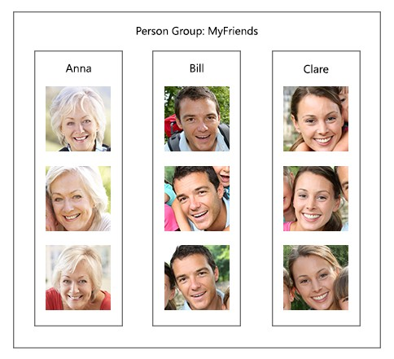
Person Identification
Understand Terms
Person Group
Notes:
Một nhóm gồm nhiều người được tập trung lại

Slide 135
Person Identification
Understand Terms
Person Group
Most important

Slide 136
Person Identification
Understand Terms
Person Group
Most important
Unique for each user

Slide 137
Person Identification
Understand Terms
Person Group
Most important
Unique for each user
Contains up to 1000 Person

Slide 138
Person Identification
Understand Terms
Person

Slide 139
Person Identification
Understand Terms
Person
Belong to an unique Person Group

Slide 140
Person Identification
Understand Terms
Person
Belong to an unique Person Group
Have an unique Person ID

Slide 141
Person Identification
Understand Terms
Person
Belong to an unique Person Group
Have an unique Person ID
Have Name, Description

Slide 142
Person Identification
Understand Terms
Person
Belong to an unique Person Group
Have an unique Person ID
Have Name, Description
Have up to 248 faces.

Slide 143



Person Identification
Understand Terms
Face
Have an unique Persisted Face ID
Hà Quân

Slide 144
Person Identification
Understand Terms
Face
Have an unique Persisted Face ID
Belong to a certain Person
Hà Quân

Slide 145
Person Identification
Train a Person
Summary –Terms

Slide 146
Person Identification
Train a Person
Summary –Terms
A User will have an unique Person Group.
Person Group

Slide 147
Person Identification
Train a Person
Summary –Terms
A User will have an unique Person Group.
A Person Group will contains different People.
Person Group
Person

Slide 148
Person Identification
Train a Person
Summary –Terms
A User will have an unique Person Group.
A Person Group will contains different People.
Each Person will have their own Faces.
Person Group
Person
Faces

Slide 149
Person Identification
Train a Person
Training Process
Create New Person
Add Person Face
Training

Slide 150
Person Identification
Train a Person
Training Process
Create New Person
Add Person Face
Training

Slide 151
Person Identification
Create New Person
Microsoft Cognitive Service
System
User

Slide 152
Person Identification
Create New Person
Microsoft Cognitive Service
System
1. Input
User
Name
Description

Slide 153
Person Identification
Create New Person
Microsoft Cognitive Service
System
Person Group
Person
1. Input
Name
Description
User
Name
Description

Slide 154
Person Identification
Create New Person
Microsoft Cognitive Service
System
Person Group
Person
2. Create Person
1. Input
Name
Description
User
Name
Description

Slide 155
Person Identification
Create New Person
Microsoft Cognitive Service
System
Person Group
Person Group
Person
Person
2. Create Person
1. Input
Name
Description
Name
Description
Person ID
User
Name
Description

Slide 156
Person Identification
Create New Person
Microsoft Cognitive Service
System
Person Group
Person Group
Person
Person
2. Create Person
1. Input
Name
Description
Name
Description
Person ID
User
Name
Description
3. Person ID

Slide 157
Person Identification
Create New Person
Microsoft Cognitive Service
System
Person Group
Person Group
Person
Person
2. Create Person
1. Input
Name
Description
Person ID
Name
Description
Person ID
User
Name
Description
3. Person ID

Slide 158
Person Identification
Train a Person
Training Process
Create New Person
2. Add Person Face
3. Training

Slide 159
Person Identification
Train a Person
Training Process
Create New Person
2. Add Person Face
3. Training

Slide 160
Person Identification
Add Person Face
Microsoft Cognitive Service
System
Person Group
Person Group
Person
Person
Name
Description
Person ID
Name
Description
Person ID
User

Slide 161

Person Identification
Add Person Face
Microsoft Cognitive Service
System
Person Group
Person Group
1. Input
Person
Person
Name
Description
Person ID
Name
Description
Person ID
User

Slide 162
Person Identification
Add Person Face
Microsoft Cognitive Service
System
Person Group
Person Group
1. Input
Person
2. Send
Person
Name
Description
Person ID
Name
Description
Person ID
User
Person ID
Person Group ID

Slide 163
Person Identification
Add Person Face
Microsoft Cognitive Service
System
Person Group
Person Group
1. Input
Person
2. Send
Person
Name
Description
Person ID
Name
Description
Person ID
User
Person ID
Person Group ID
Face

Slide 164
Person Identification
Add Person Face
Microsoft Cognitive Service
System
Person Group
Person Group
1. Input
Person
2. Send
Person
Name
Description
Person ID
Name
Description
Person ID
User
Person ID
Person Group ID
Face
3. Return
Persisted Face ID

Slide 165
Person Identification
Add Person Face
Microsoft Cognitive Service
System
Person Group
Person Group
1. Input
Person
2. Send
Person
Name
Description
Person ID
Name
Description
Person ID
User
Person ID
Face
Face
Person Group ID
Persisted Face ID
3. Return
Persisted Face ID

Slide 166
Person Identification
Train a Person
Training Process
Create New Person
Add Person Face
3. Training

Slide 167
Person Identification
Train a Person
Training Process
Create New Person
Add Person Face
3. Training

Slide 168
Person Identification
Training
Microsoft Cognitive Service
System
Person Group
User

Slide 169
Person Identification
Training
Microsoft Cognitive Service
System
Person Group
1. Train
User

Slide 170
Person Identification
Training
Microsoft Cognitive Service
System
Person Group
2. Send
1. Train
Person Group ID
User

Slide 171

Person Identification
Training
Microsoft Cognitive Service
System
Person Group
Person Group
2. Send
1. Train
Person Group ID
User
Train Person Group

Slide 172
Person Identification
Training
Microsoft Cognitive Service
System
Person Group
Person Group
2. Send
1. Train
Person Group ID
User
3. Return Status
4. Notify
Train Person Group

Slide 173
Person Identification
Train a Person
Training Process
Create New Person
Add Person Face
Training

Slide 174
Person Identification
Demo
Training a Person

Slide 175
Person Identification
Summary – Demo Training Unidentified Person

Slide 176
Person Identification
Summary – Demo Training Unidentified Person
New Person is successfully added into system.

Slide 177
Person Identification
Summary – Demo Training Unidentified Person
New Person is successfully added into system.
System can now Identify trained Person.

Slide 178
Real-time
Face Recognition
Introduction

Slide 179
Person Identification
Scenario
This is great, but do I have to give the command every time ?
Notes:
Quay trở lại với vấn đề nêu trên => giờ đã có thể nhận diện được đó là ai

Slide 180
Person Identification
Problem
This is great, but do I have to give the command every time ?
Giving command every time Mr. Son meets somebody is pretty inconvenient.
Notes:
Quay trở lại với vấn đề nêu trên => giờ đã có thể nhận diện được đó là ai

Slide 181
Person Identification
Problem
This is great, but do I have to give the command every time ?
Giving command every time Mr. Son meets somebody is pretty inconvenient.
Is there a way that can help Mr. Son Identify person more comfortably ? Or “Hand-free” ?
Notes:
Quay trở lại với vấn đề nêu trên => giờ đã có thể nhận diện được đó là ai

Slide 182
Person Identification
Solution
Real-time Identification Process

Slide 183
Person Identification
Solution
Detect Person Face Continuously and
Automatically
System
Notes:
#need to talk about process of detect face???

Slide 184
Person Identification
Solution
Detect Person Face Continuously and
Automatically
Describe the Person back to the blind
System

Slide 185
Person Identification
Solution
Detect Person Face Continuously and
Automatically
Describe the Person back to the blind
System
Blind user does not have to give command every time

Slide 186
Person Identification
Solution
Detect Person Face Continuously and
Automatically
Describe the Person back to the blind
System
Blind user does not have to give command every time
Hand-free, more convenient

Slide 187
Person Identification
How can we do that ?

Slide 188
Person Identification
How can we do that ?
Continuously Streaming
Device Camera

Slide 189
Person Identification
How can we do that ?
Continuously Streaming
Detect Human Face
Device Camera

Slide 190

Person Identification
How can we do that ?
Continuously Streaming
Detect Human Face
Device Camera
Capture Picture
Microsoft Cognitive Service

Slide 191
Person Identification
How can we do that ?
Continuously Streaming
Detect Human Face
Device Camera
Capture Picture
Microsoft Cognitive Service
Response Result

Slide 192
Person Identification
How can we do that ?
Continuously Streaming
Detect Human Face
Device Camera
Capture Picture
Microsoft Cognitive Service
Response Result
Blind user

Slide 193
Person Identification
Demo
Real-time Identifying Process

Slide 194
Person Identification
Summary – Demo Real-time Identifying Process
Everything is automatic !
Notes:
Quay trở lại với vấn đề nêu trên => giờ đã có thể nhận diện được đó là ai

Slide 195
Person Identification
Summary – Demo Real-time Identifying Process
Mr. Son does not have to give command to identify every time he meets somebody.
Everything is automatic !
Notes:
Quay trở lại với vấn đề nêu trên => giờ đã có thể nhận diện được đó là ai

Slide 196
Person Identification
Summary – Demo Real-time Identifying Process
Mr. Son does not have to give command to identify every time he meets somebody.
Totally “Hand-free”.
Everything is automatic !
Notes:
Quay trở lại với vấn đề nêu trên => giờ đã có thể nhận diện được đó là ai

Slide 197
Introduction
Detect Object

Slide 198
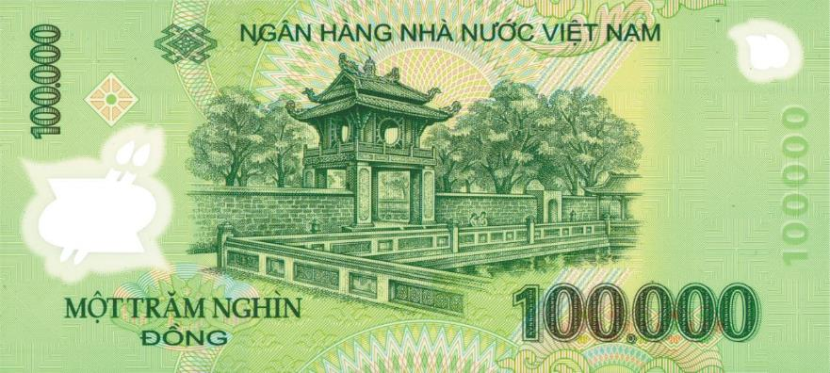
Object recognition
Problem
How much is it?
Mr. Long

Slide 199
Object recognition
Our Proposal

Slide 200
Object recognition
Our Proposal
System

Slide 201
Object recognition
Our Proposal
Detect Object
System

Slide 202
Object recognition
Our Proposal
Describe information back to the blind
Detect Object
System

Slide 203
Object recognition
Our Proposal
Describe information back to the blind
Detect Object
System
The blind know what it is

Slide 204
Object recognition
Our Proposal
Describe information back to the blind
Detect Object
System
Blind can do right thing with it
The blind know what it is

Slide 205

Object recognition
How can we do that ?
Camera
System
Clarifai Service
Take picture
Process
Identify object

Slide 206
Object recognition
How can we do that ?
1. Capture Picture
Camera

Slide 207
Object recognition
How can we do that ?
1. Capture Picture
Camera
System

Slide 208
Object recognition
How can we do that ?
2. Send Image
1. Capture Picture
Camera
System
3. Response Result
Clarifai Service

Slide 209
Object recognition
How can we do that ?
2. Send Image
1. Capture Picture
Camera
System
3. Response Result
Clarifai Service
4. Process

Slide 210
Object recognition
How can we do that ?
2. Send Image
1. Capture Picture
Camera
System
3. Response Result
Clarifai Service
4. Process
5. Describe
Blind user

Slide 211
Object recognition
Technology

Slide 212

Object recognition
Technology
Image Recognition system
Detect faces, colors…
Custom training
Search images

Slide 213
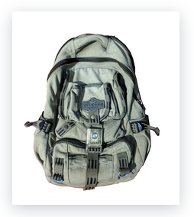
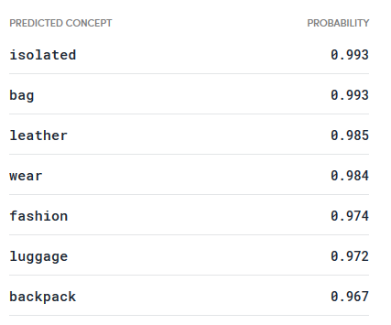
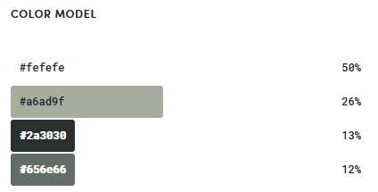
Object recognition
Technology
Input
Output
Notes:
Neu input la tam nay ---

Slide 214
Object recognition
Technology
How it works?
Clarifai use a technique called Convolution Neural Networks(CNNs) to object recognition

Slide 215

Object recognition
Technology
What is Convolution?

Slide 216

Object recognition
Technology
Neural Networks?

Slide 217
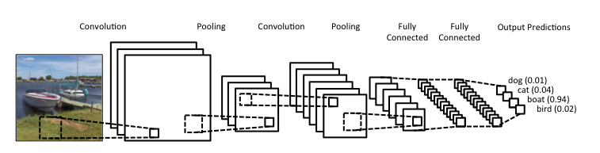
Object recognition
Technology
Convolutional Neural Networks?

Slide 218
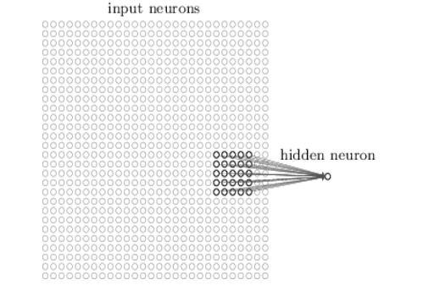
Object recognition
Technology
Local receptive field
28x28

Slide 219
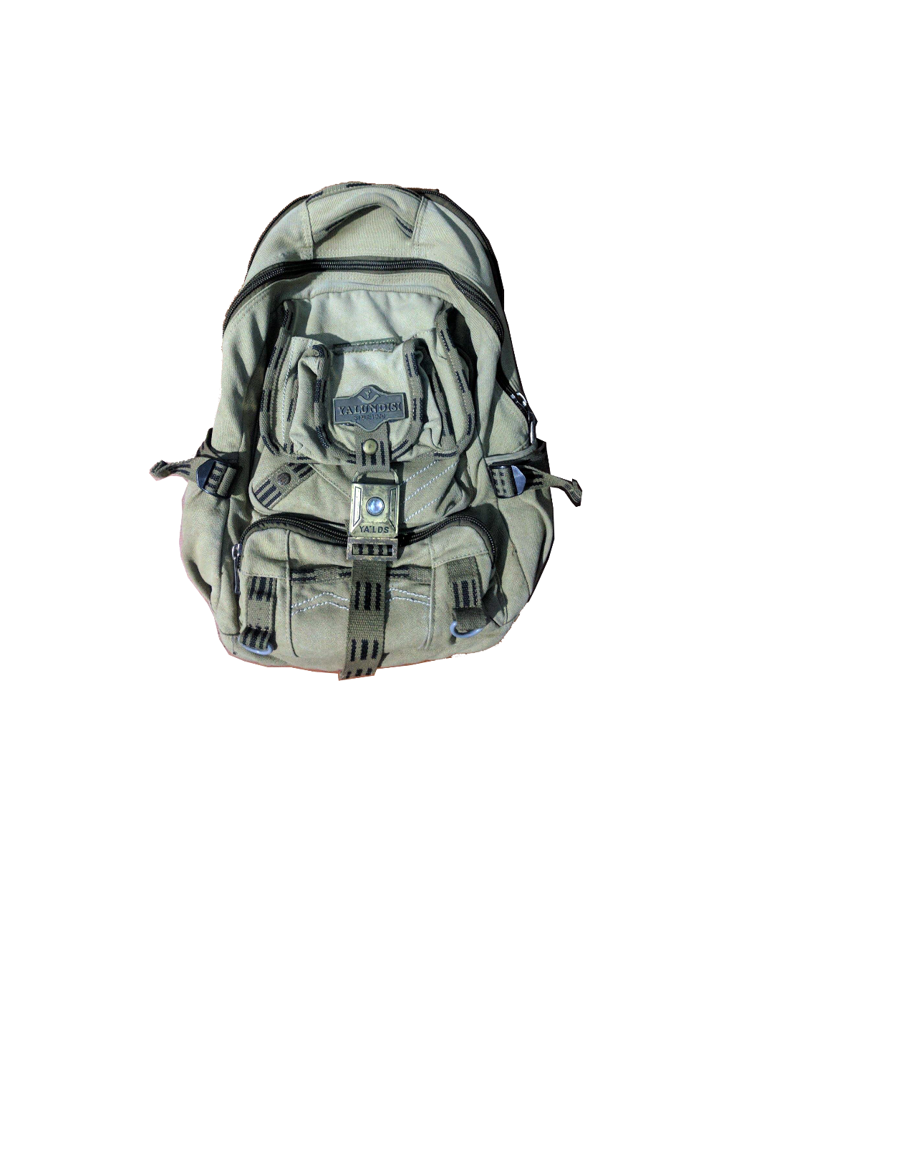
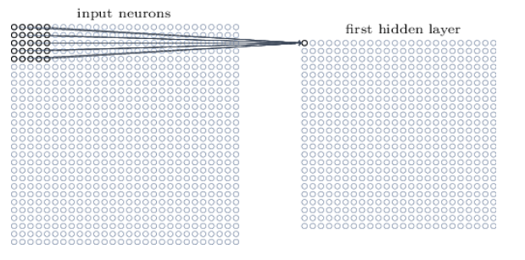
Object recognition
Technology
28x28
24x24

Slide 220

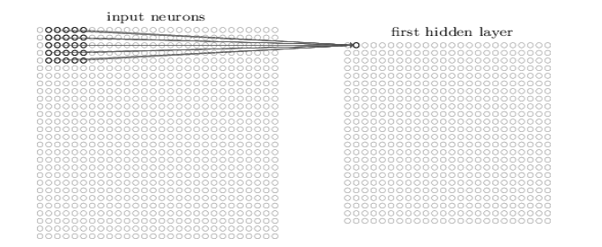
Object recognition
Technology
28x28
24x24

Slide 221

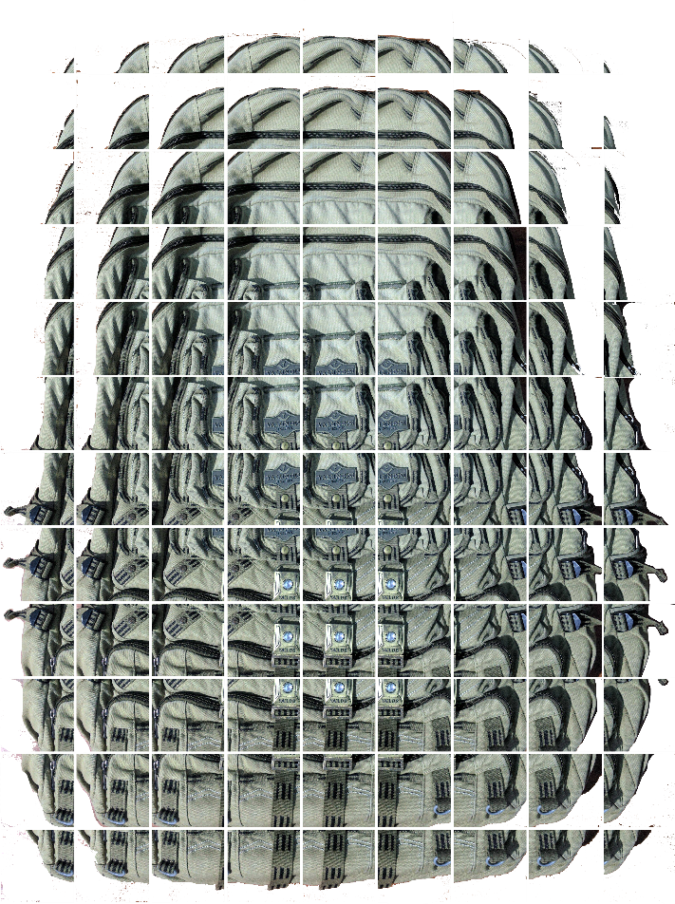
Object recognition
Technology

Slide 222
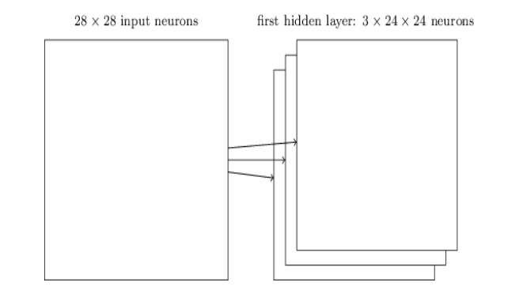

Object recognition
Technology
Feature map
Filter

Slide 223

Object recognition
Technology

Slide 224
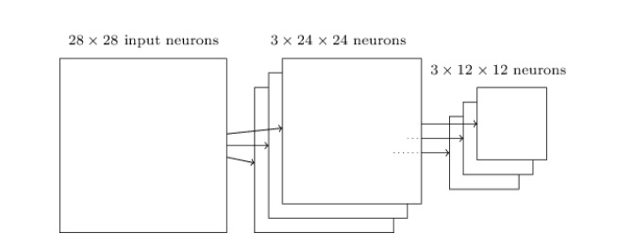

Object recognition
Technology

Slide 225
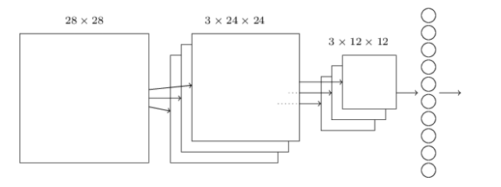
Object recognition
Technology

Slide 226
Object recognition
Technology
Convolutional Neural Networks
Notes:
Size nho - >nhanh

Slide 227
Object recognition
Detect an Object
How can Clarifai service recognize an object?

Slide 228
Object recognition
Detect an Object
Understand Terms
Model
Concept
Input

Slide 229
Object recognition
Understand Terms
Model
Model: Animal
Model have unique Model ID
Group input(Images, videos…) to predictions

Slide 230
Object recognition
Understand Terms
Concept
Model: Animal
Belong to a unique Model
Have a unique Concept ID
Dog
Cat
Four Legs

Slide 231
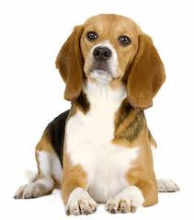
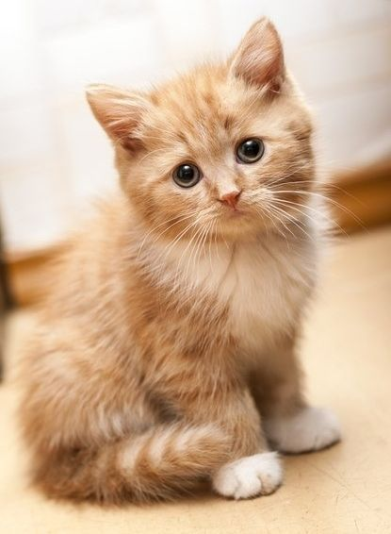
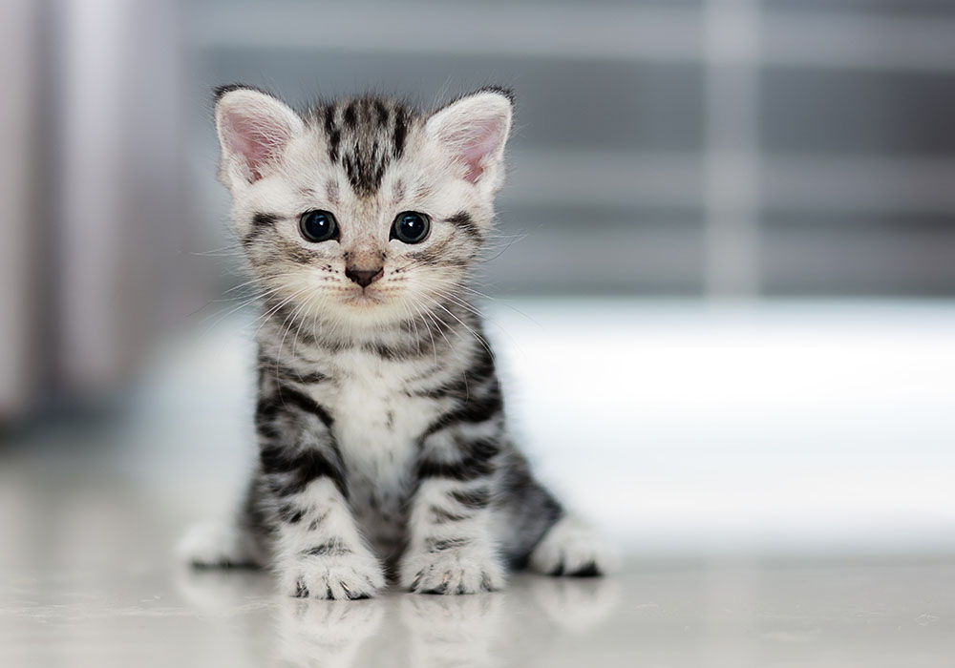
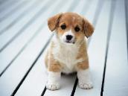
Object recognition
Understand Terms
Input
Model: Animal
Have a unique Input ID
Have one or many concept
Dog
Cat
Four Legs

Slide 232
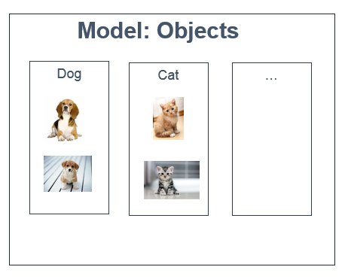
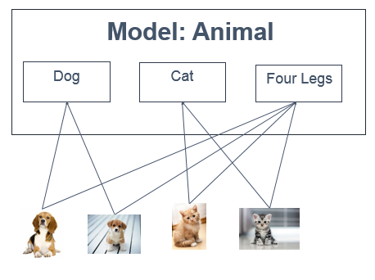
Object recognition
Apply in our system
Search faster
Unnecessary abstract concept (eg. Four legs)
Need exact name of the object

Slide 233



Demo
Training Objects
Admin Training
Mr Nam

Slide 234



Object recognition
Detect Object
Get URL picture
3
1
2
4
Write log
No
Detectable?
4.1.1
4.1
4.2
Get information Obejct
Yes
4.2.1

Slide 235

Demo
Detect Objects
Mr Nam

Slide 236
Out come

Slide 237
Out come
Problems solved
Identify Person and Objects with high accuracy ( >= 80% )
The blind can use app by voice

Slide 238
Out come
Problems solved
Limitations
Only available on Android OS
Need internet connection
Identify Person and Objects with high accuracy ( >= 80% )
The blind can use app by voice

Slide 239
Automatic Alternative Image Recognition to Voice
Future Plan
Support multiple platforms: iOS, Window phone or smart glasses
Improve voice control
Offline identification.

Slide 240
Thank you for listening !

